Slide 1
There Was An Old Lady Who Swallowed A Bell
Sequencing for Preschoolers

Slide 2
What item did the little old lady swallow 1st?

Slide 3
You’re right! She swallowed a BELL.
This Photo by Unknown Author is licensed under CC BY-NC

Slide 4
What did the little old lady swallow 2nd?

Slide 5
She swallowed the BOWS. Was that YOUR guess?

Slide 6
What did the old lady swallow AFTER the bows?

Slide 7
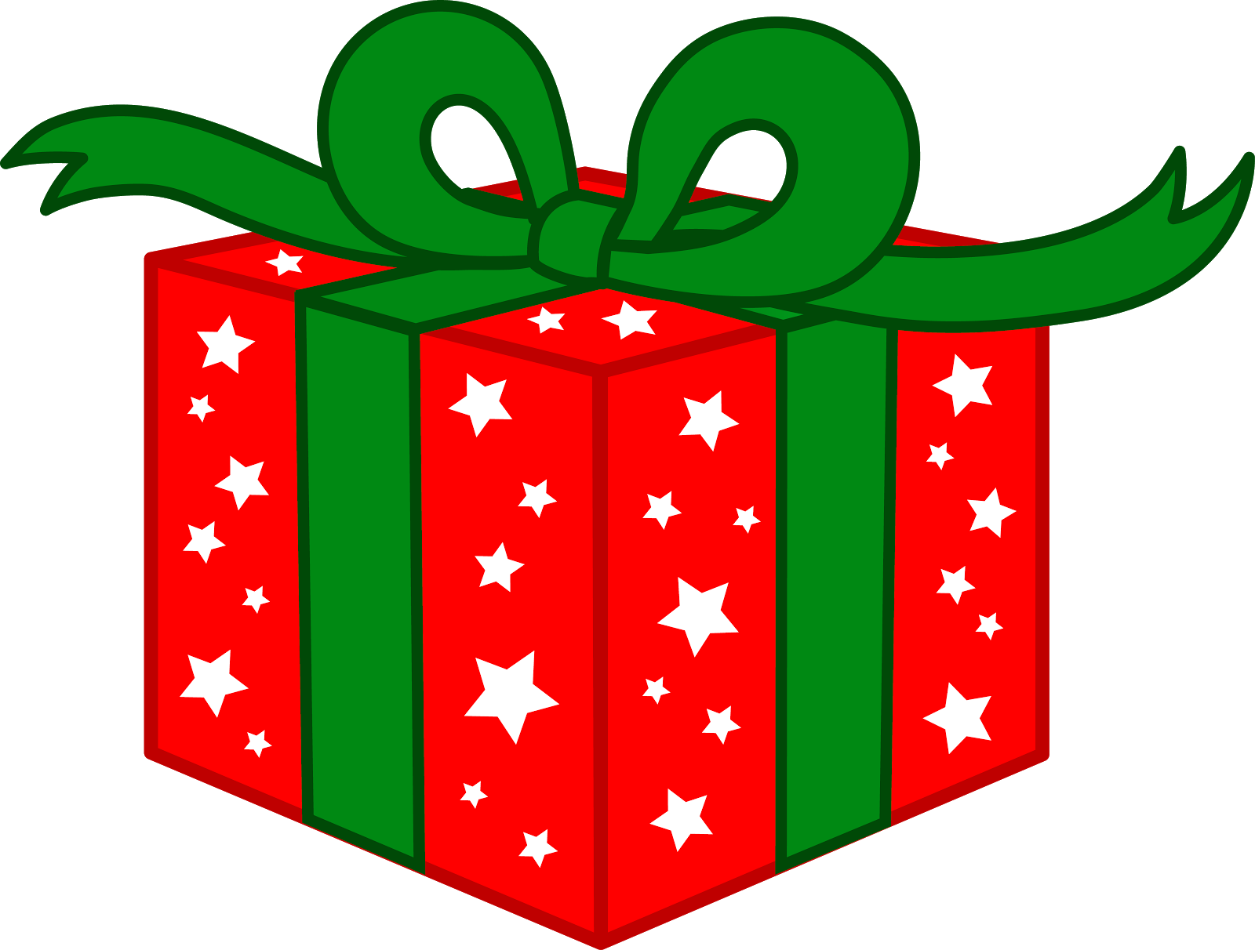
Yes! She swallowed some gifts.

Slide 8
What did the old lady swallow to hold the gifts?

Slide 9
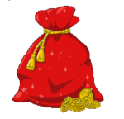
Did you guess a SACK?

Slide 10
What item did the old lady swallow after the sack? Think carefully…

Slide 11
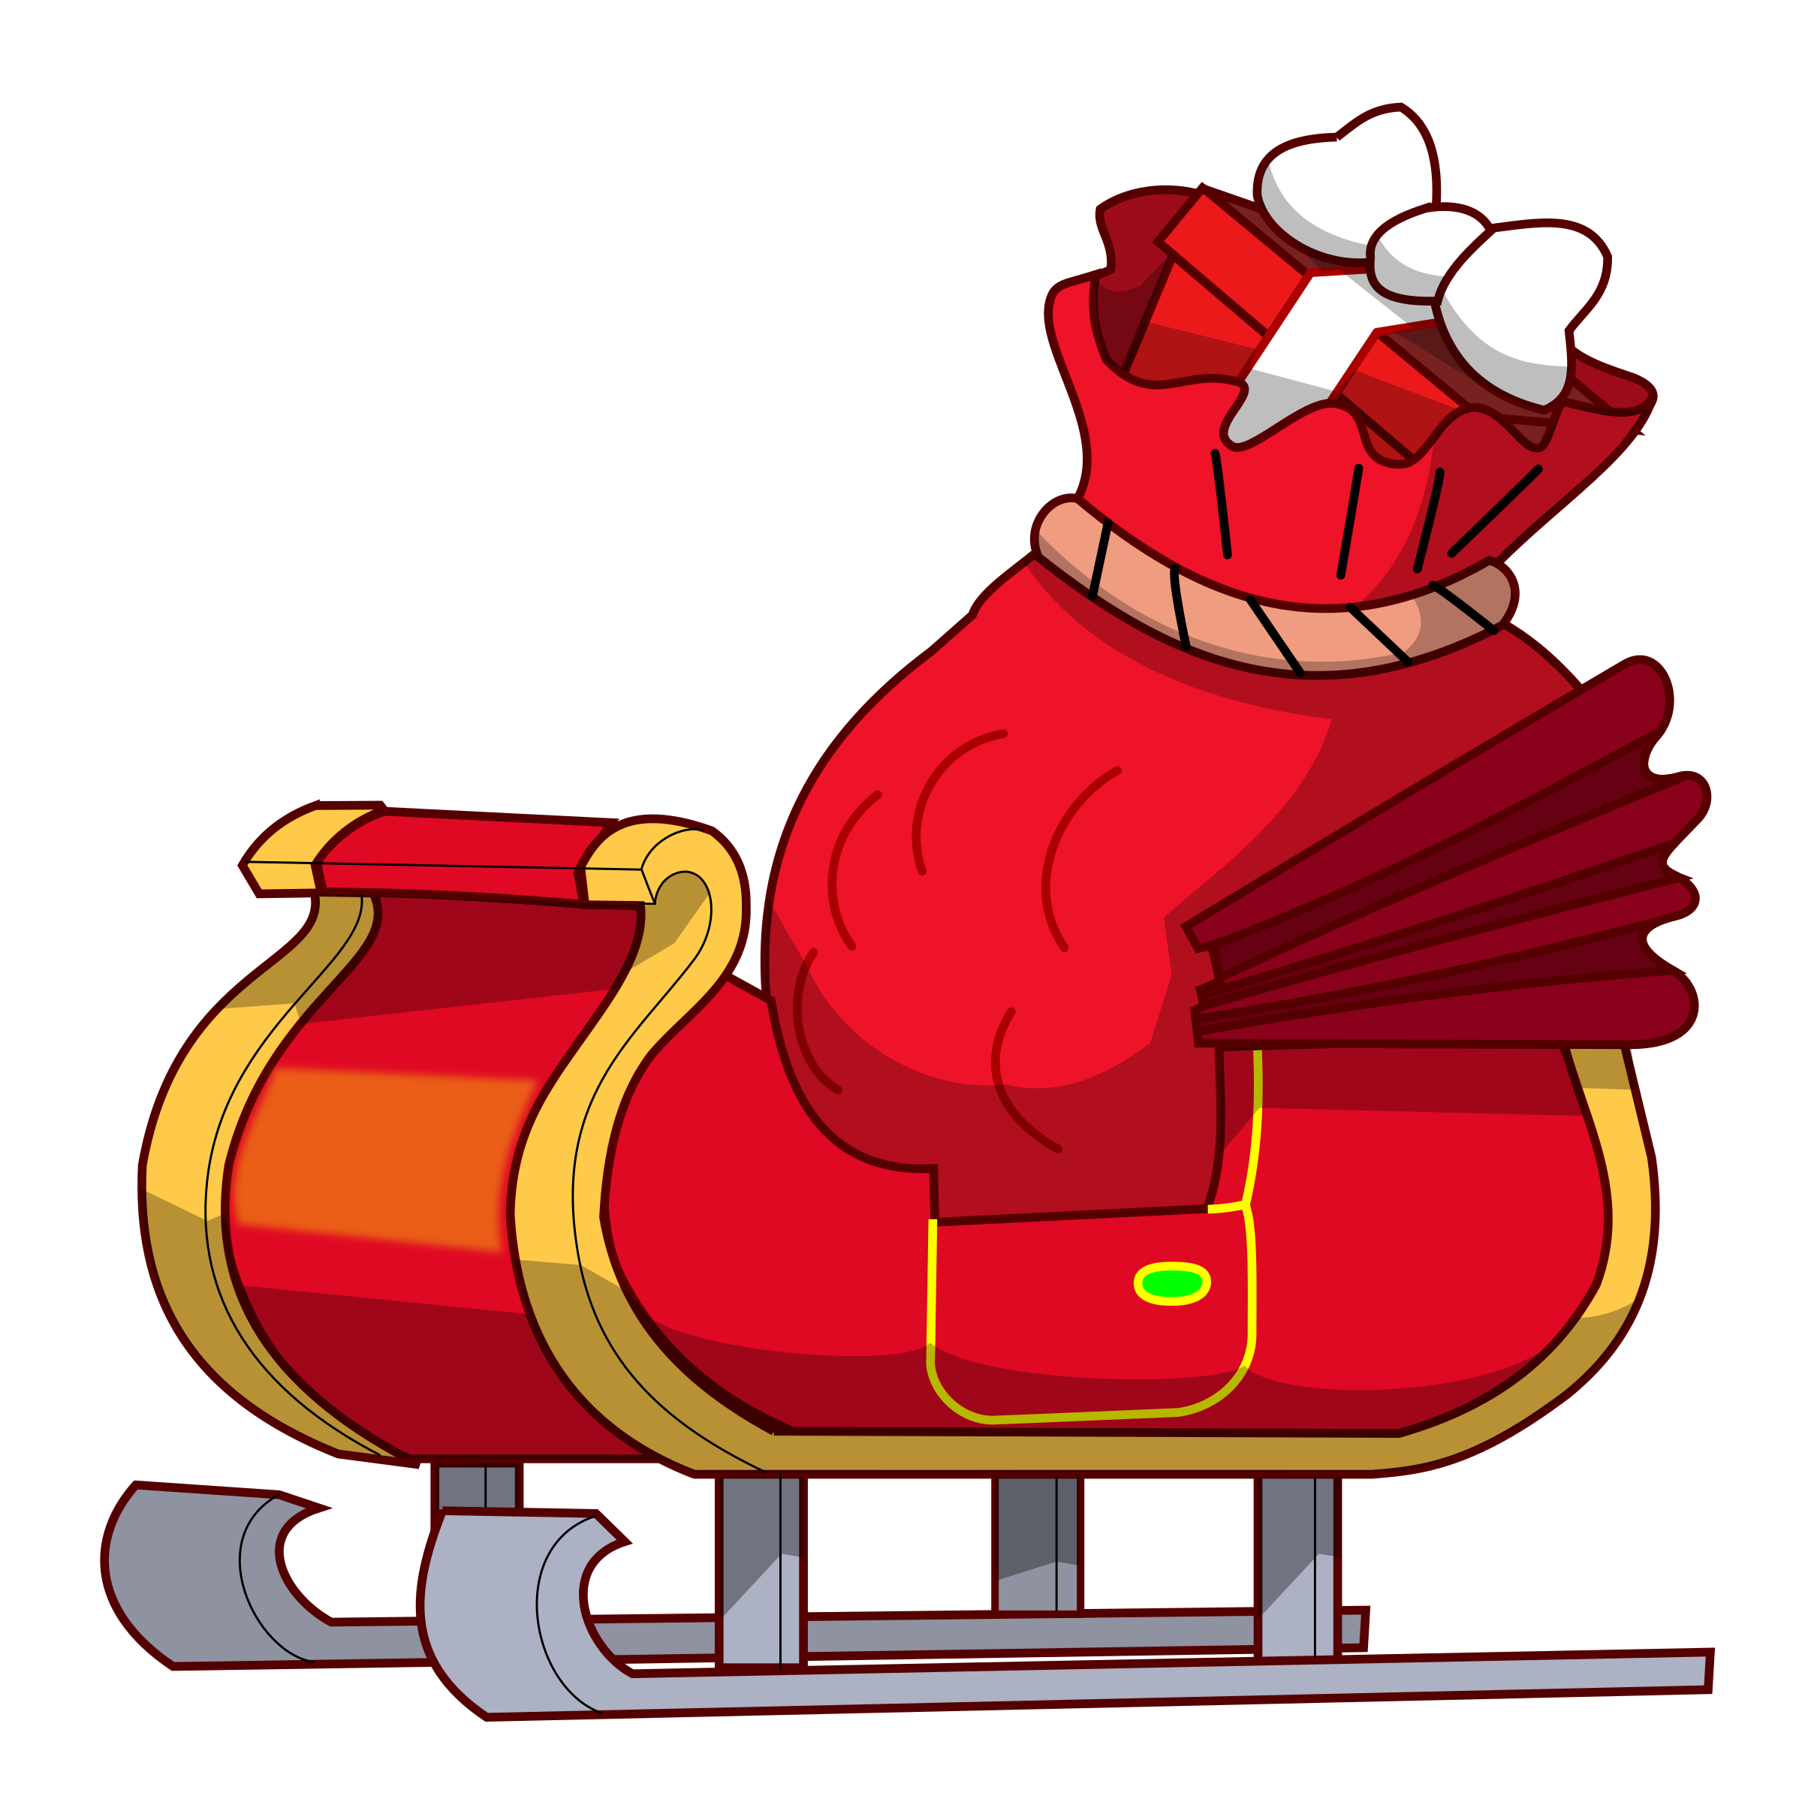
Hooray, she swallowed a red sleigh.

Slide 12
What did the little old lady swallow to pull the sleigh?

Slide 13
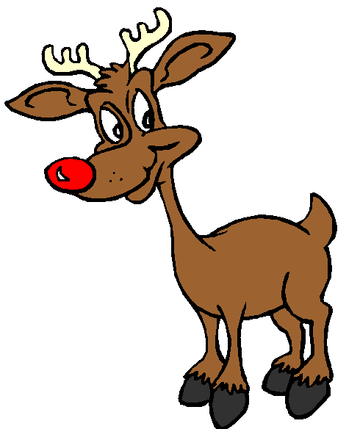
YES! The little old lady swallowed the REINDEER.

Slide 14
Do you remember what treat the old lady swallowed?

Slide 15
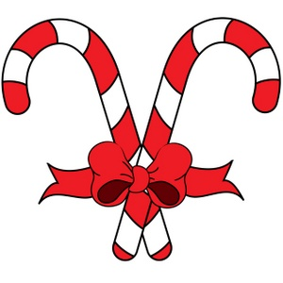
Yes, the sweet treat was a CANDY CANE!

Slide 16
Who was waiting for a ride near the end of the story?

Slide 17
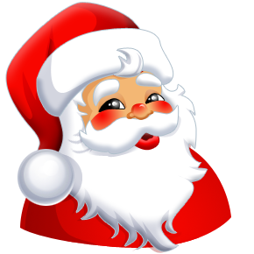
SANTA CLAUS was waiting for a ride!

Slide 18
What two words that BEGIN with the letter H are at the end of the book?

Slide 20
For more ways to learn and play with your own preschoolers this year, please visit us at: The Preschool Toolbox Blog

