Slide 1
There Was An Old Lady Who Swallowed Some Leaves
What Am I?

Slide 2
What did the old lady swallow first?

Slide 3
What did the old lady swallow second?

Slide 4

What did the old lady swallow third?

Slide 5
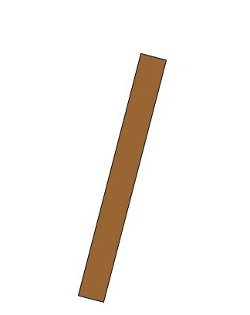
What did the old lady swallow fourth?

Slide 6
What did the old lady swallow fifth?

Slide 7
What did the old lady swallow sixth?

Slide 8
What did the old lady swallow seventh?

Slide 9
What am I?

