Slide 1
Transportation Clues

Slide 2
“All Aboard!”
Clackity-clack.
We go speeding
Down the track.
What is it?

Slide 3

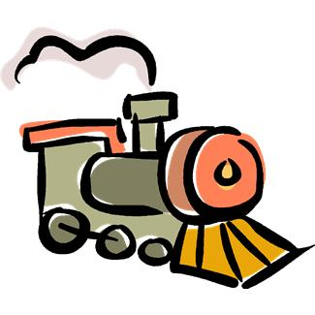

Slide 4
The pilot takes us up so high.
Like a giant “bird” up in the sky.
What is it?

Slide 5
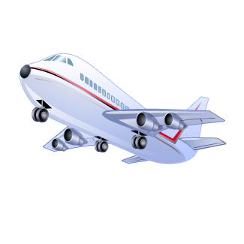

Slide 6
With seat belts on,
We drive around.
We stop and go
All over town.
What is it?

Slide 7
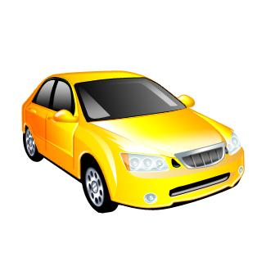

Slide 8
Big yellow doors
Swing open wide.
To get to school,
We ride inside.
What is it?

Slide 9
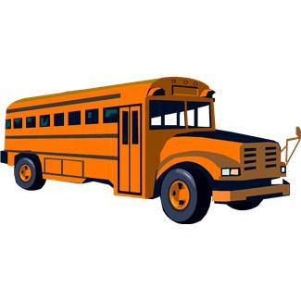

Slide 10
Up in the sky,
Above the clouds,
Propeller whirring,
Fast and loud.
What is it?

Slide 11
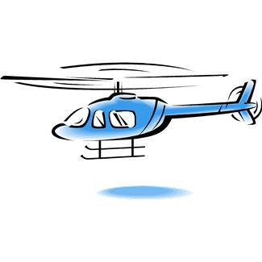

Slide 12
Across the lake
I row and row
The harder I pull,
The faster I go.
What is it?

Slide 13
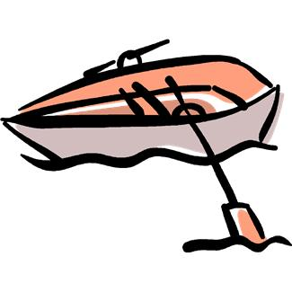

Slide 14
Big white sail,
Wind in my face.
Over the waves,
We bump and race.
What is it?

Slide 15
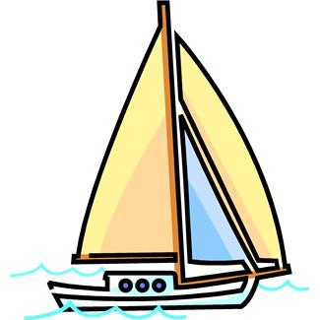

Slide 16
Pedals twirl
And wheels turn.
We ride to school
And then return.
What is it?

Slide 17


